Slide 1
DocGCN Architecture

Slide 2
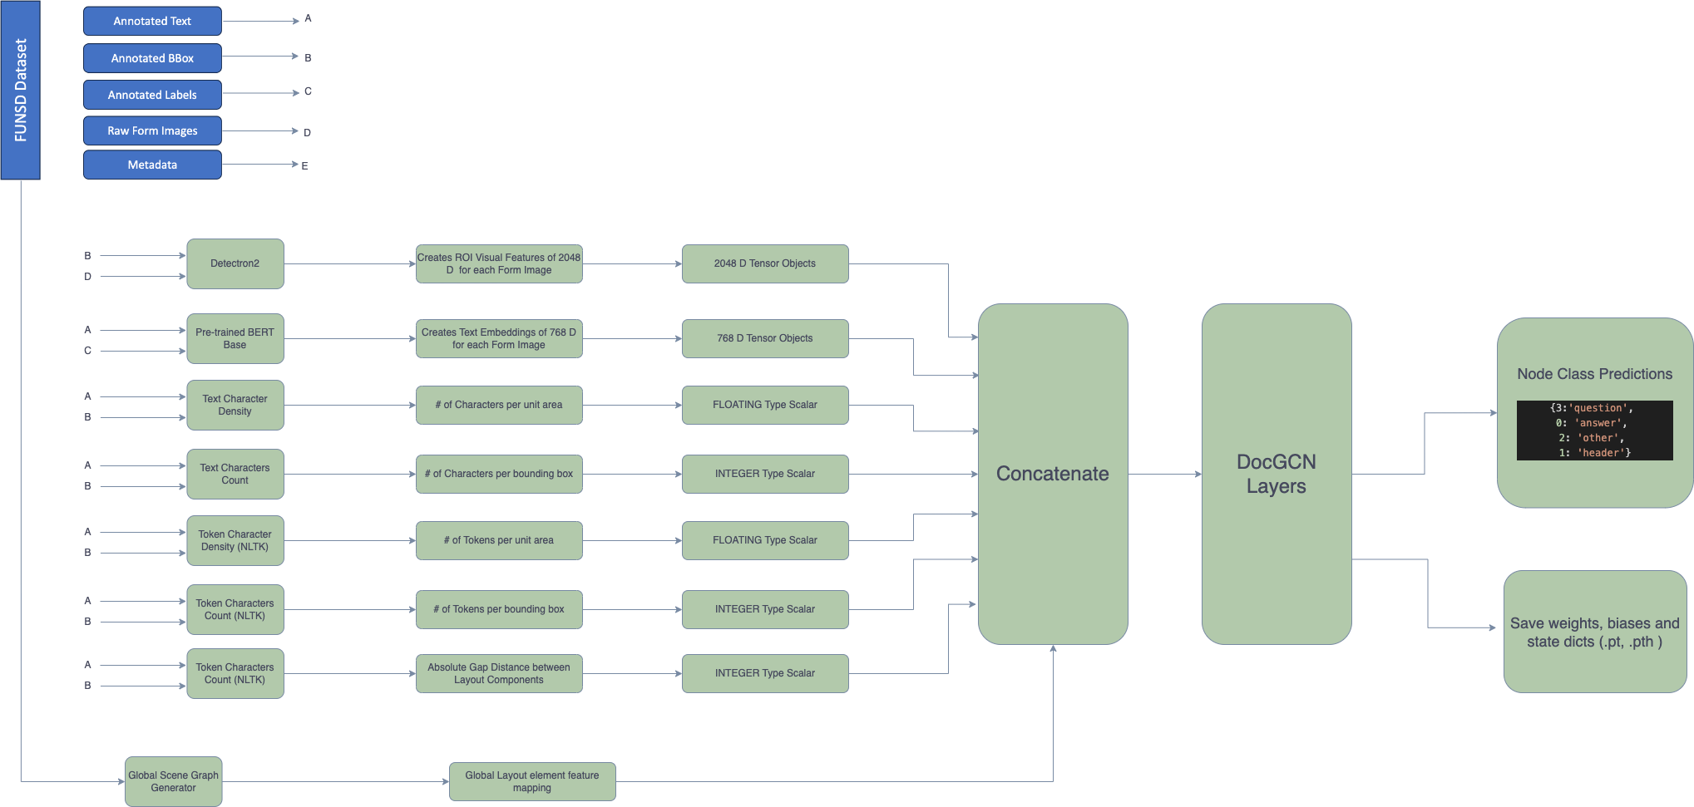
Training Architecture

Slide 3
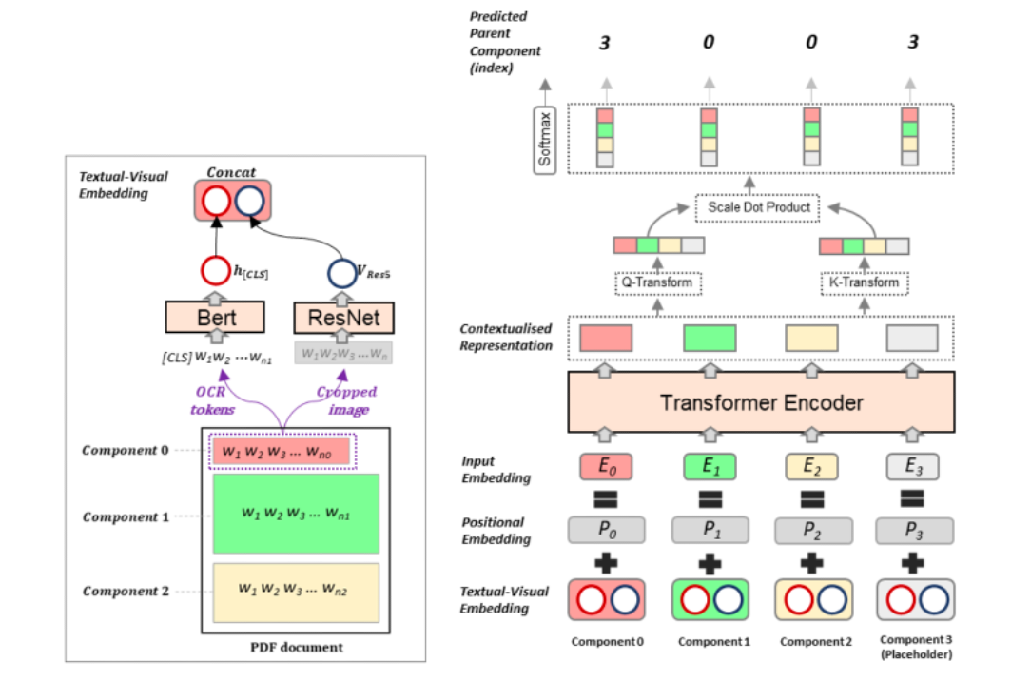
DocGCN Layers [PyTorch]

Slide 4
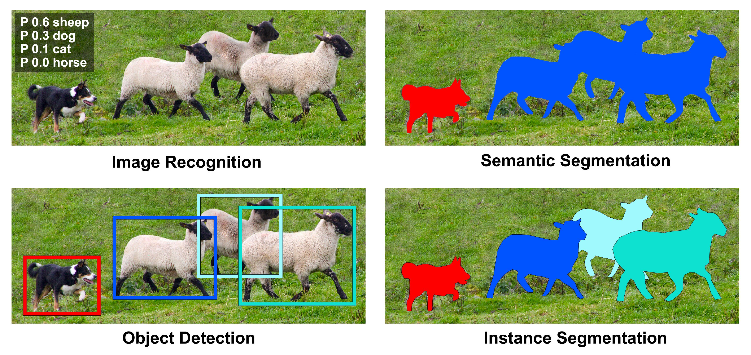
Detectron2 Module
Detectron2 is Facebook AI Research’s (FAIR) next generation library that provides state-of-the-art object detection and segmentation algorithms. It is the successor of Detectron and maskrcnn-benchmark. It supports a number of computer vision research projects and production applications in Facebook.
It is now implemented in PyTorch. Detectron2 is flexible and extensible, and able to provide fast training on single or multiple GPU servers. Lots of pre-trained models available in Model Zoo to experiment with.
Includes new capabilities such as panoptic segmentation, Densepose, Cascade R-CNN, rotated bounding boxes, PointRend, DeepLab, ViTDet, MViTv2 etc.
Detectron2 based models can be exported to TorchScript format or Caffe2 format for deployment. It trains much faster than predecessor. Its extensible design makes it easy to implement cutting-edge research projects without having to fork the entire codebase.
Outputs
Class Label
Prediction %
Bounding box
Segmented Masks
Object bare skeleton

Slide 5
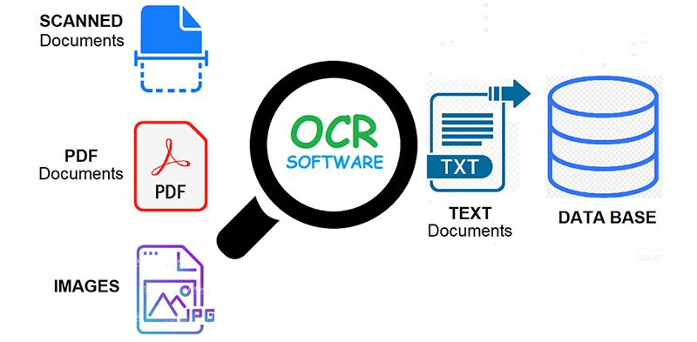
Tesseract OCR
Tesseract is an open-source OCR engine developed primarily by HP and later managed by Google that recognizes more than 100 languages, along with the support of ideographic and right-to-left languages. Also, we can train Tesseract to recognize other languages.
It contains two OCR engines for image processing and character recognition – a default LSTM (Long Short Term Memory) OCR engine and a legacy OCR engine that works by recognizing character patterns.
The OCR engine uses the Leptonica library to open the images and supports various output formats like plain text, hOCR (HTML for OCR), PDF, and TSV.
First part is to read the image using OpenCV and then pass the image to image_to_string() or image_to_data() method of the pytesseract class along with the language (eng).
Operation Modes
0 Legacy engine only.
1 Neural nets LSTM engine only.
2 Legacy + LSTM engines.
3 Default, based on what is available.

Slide 6
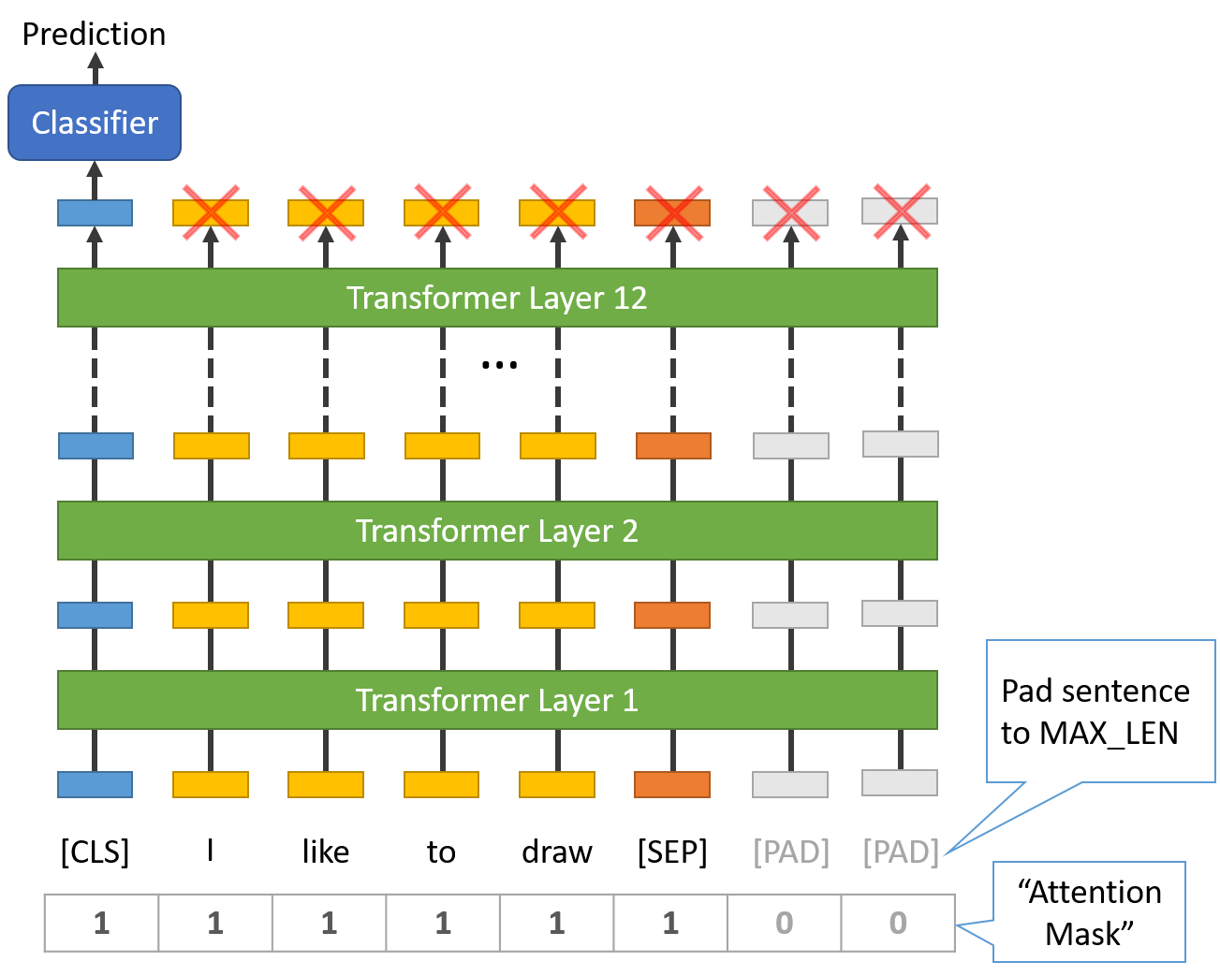
Pretrained BERT
BERT is a transformers model pretrained on a large corpus of English data in a self-supervised fashion. This means it was pretrained on the raw texts only, with no humans labeling them in any way with an automatic process to generate inputs and labels from those texts.
Masked language modeling (MLM):
Taking a sentence, the model randomly masks 15% of the words in the
input then run the entire masked sentence through the model and it
has to predict the masked words.
Next sentence prediction (NSP):
The models concatenates two masked sentences as inputs during pretraining.
Sometimes they correspond to sentences that were next to each other in the
original text, sometimes not. The model then has to predict if the two
sentences were following each other or not.
This way, the model learns an inner representation of the English language
that can then be used to extract features useful for downstream tasks.
A standard classifier uses the features produced by the BERT model as inputs.

Slide 7
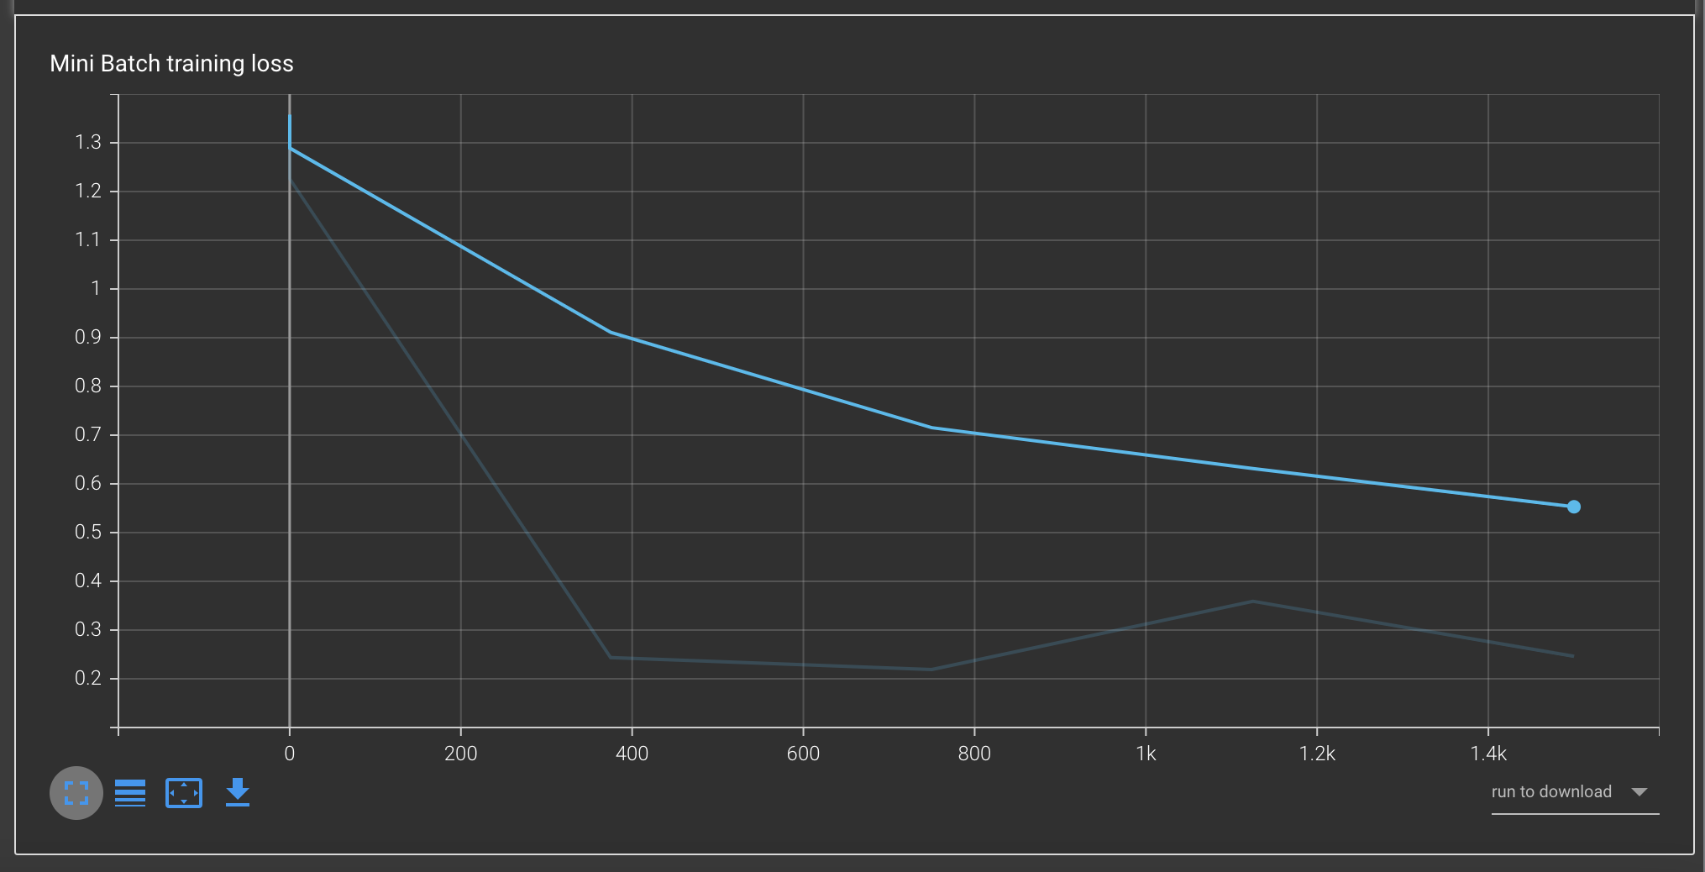
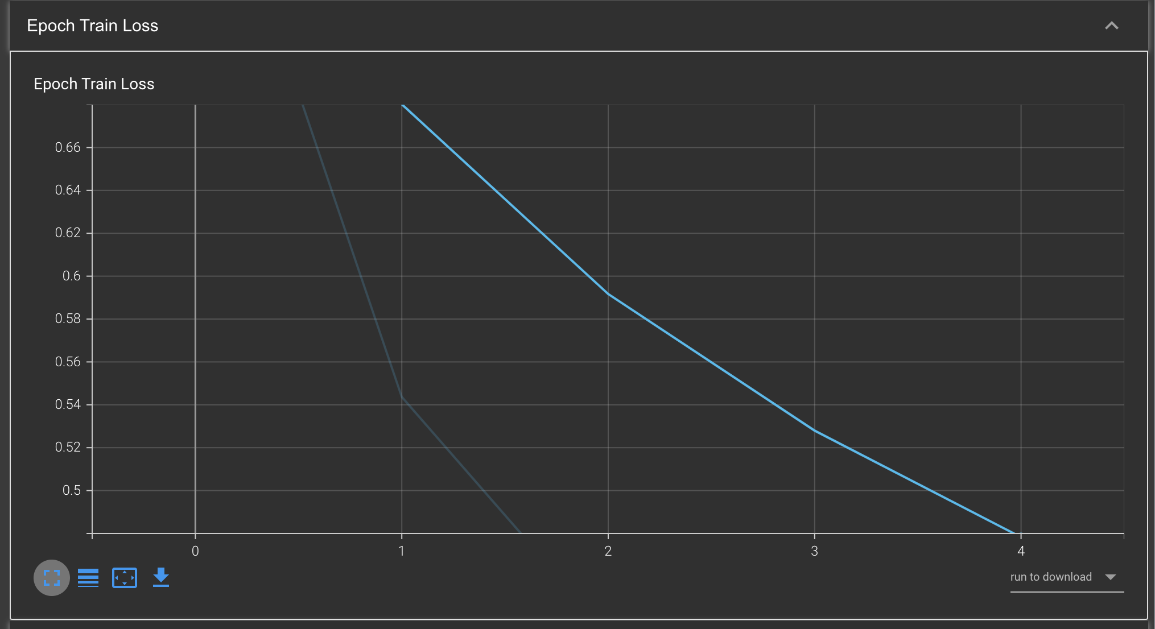
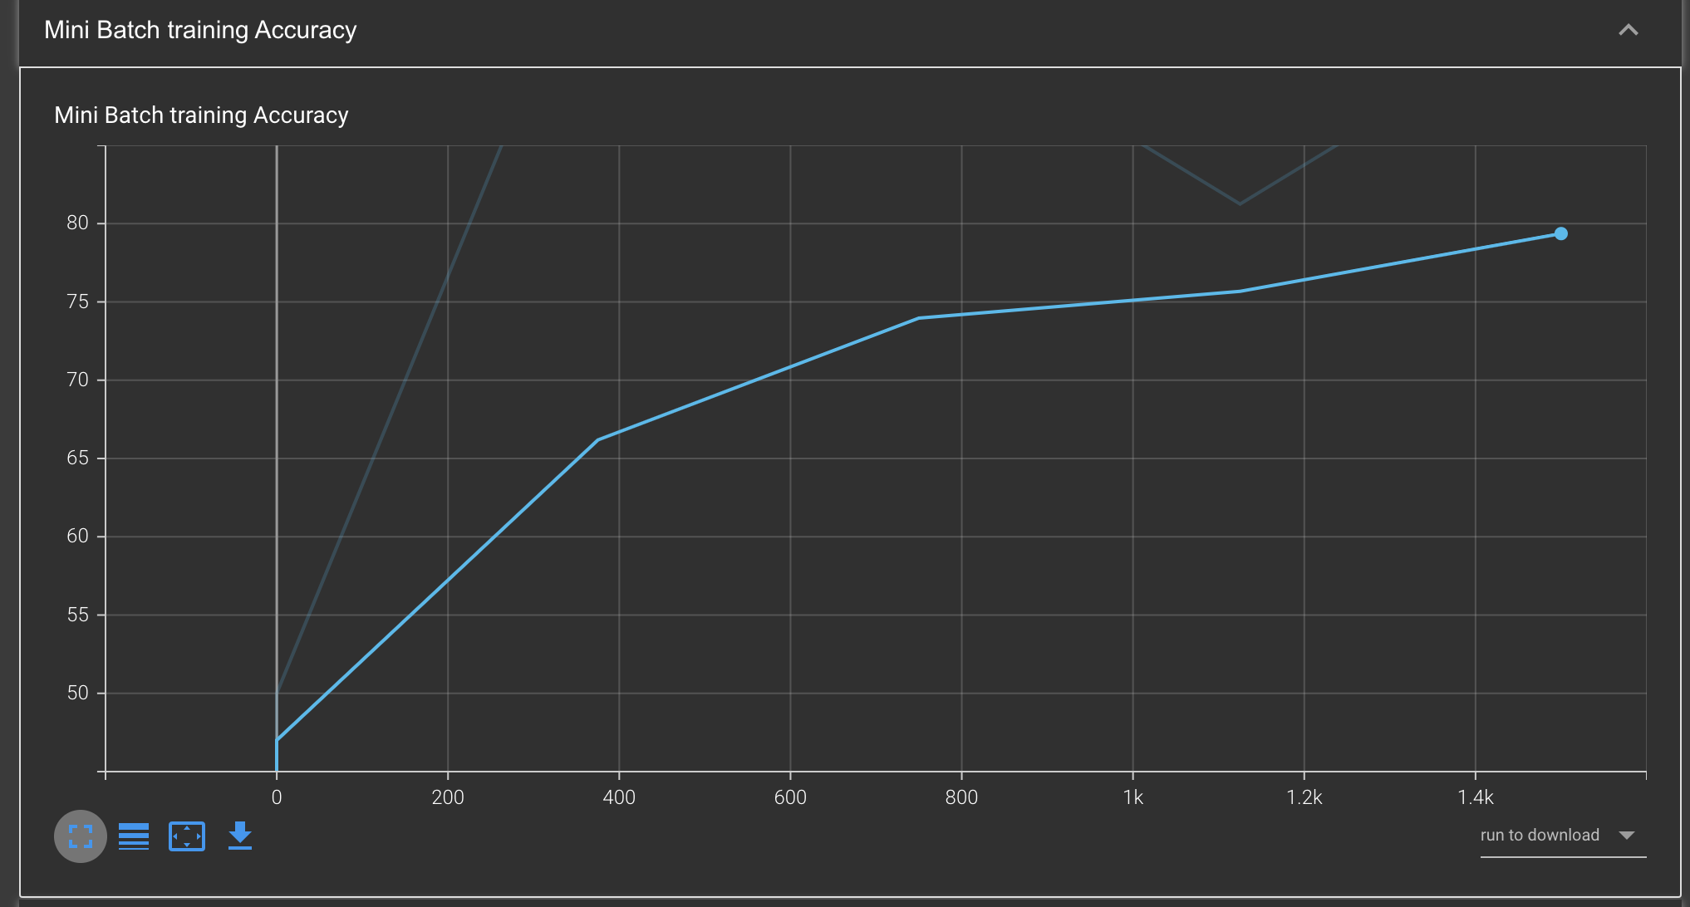
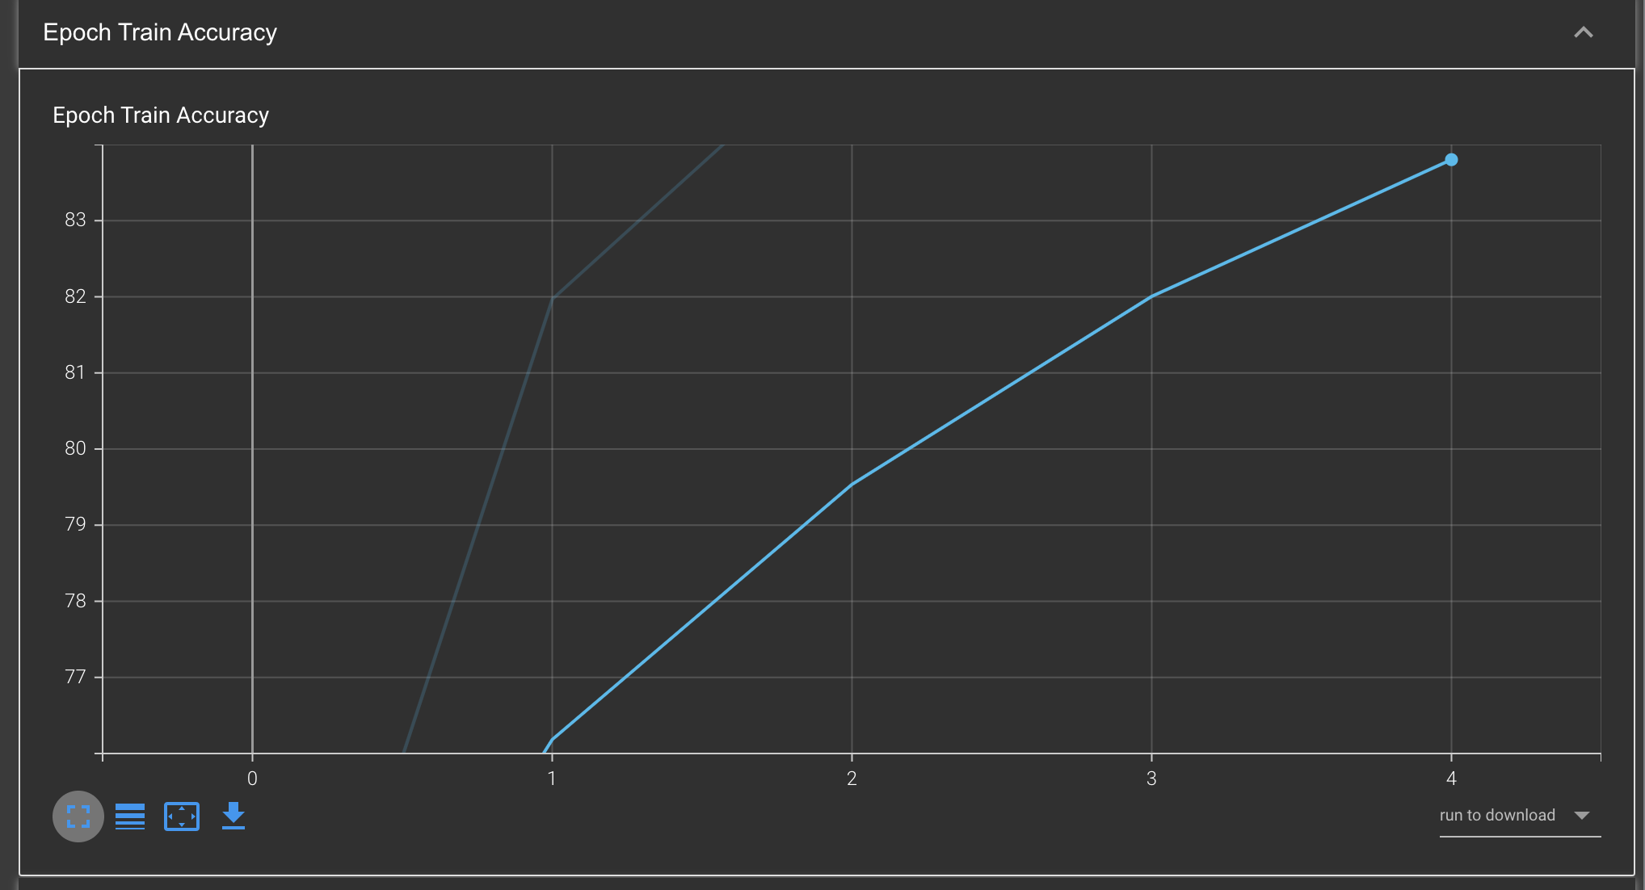
Training Graphs

Slide 8
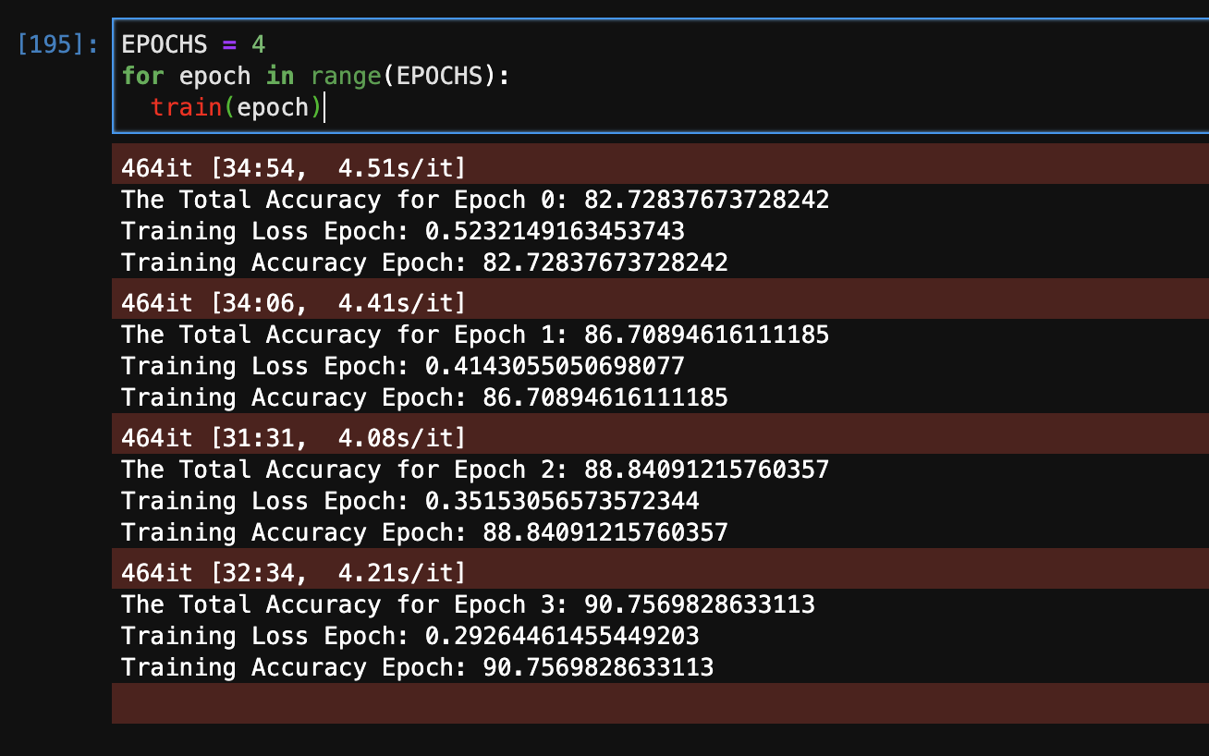
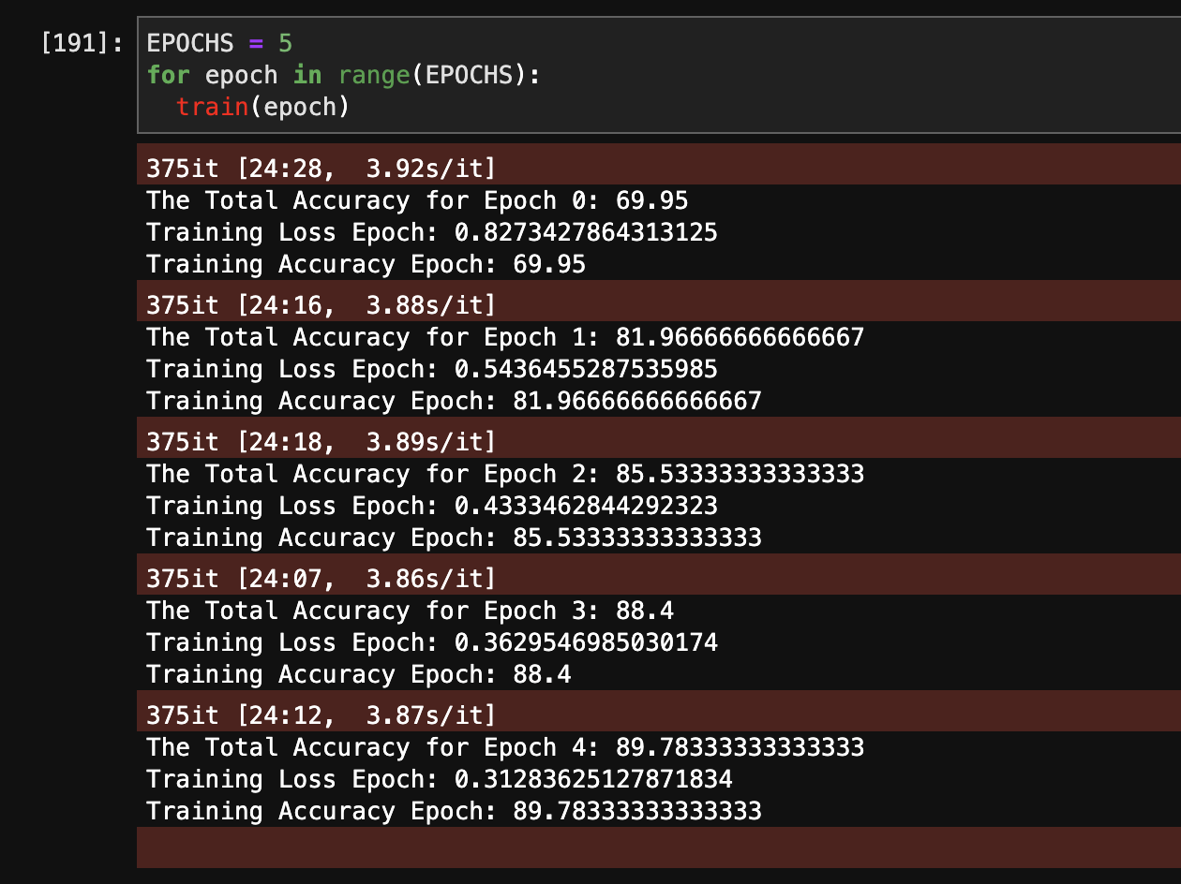
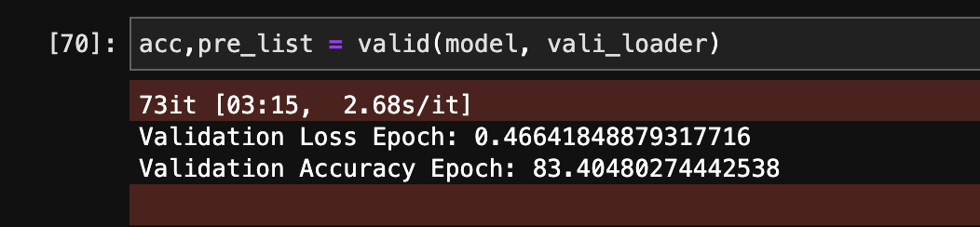
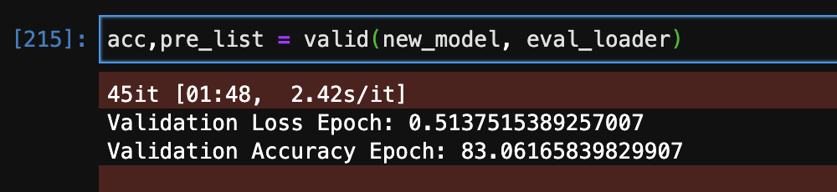
Training Report

Slide 9
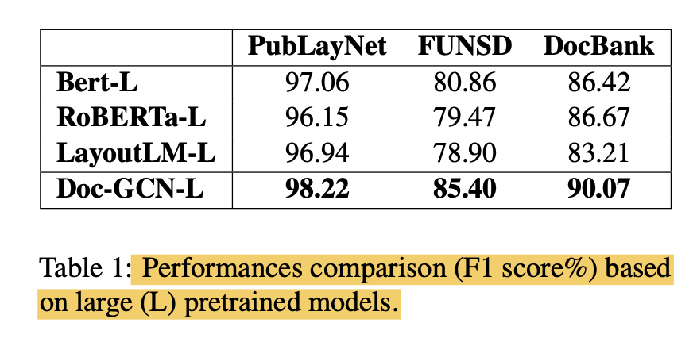
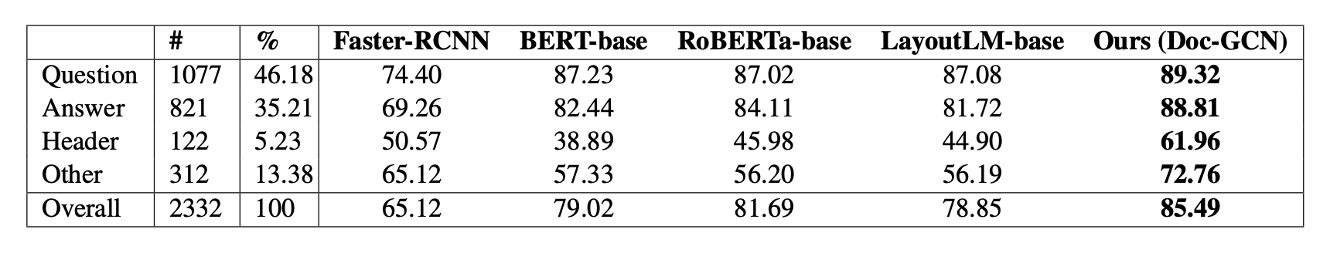
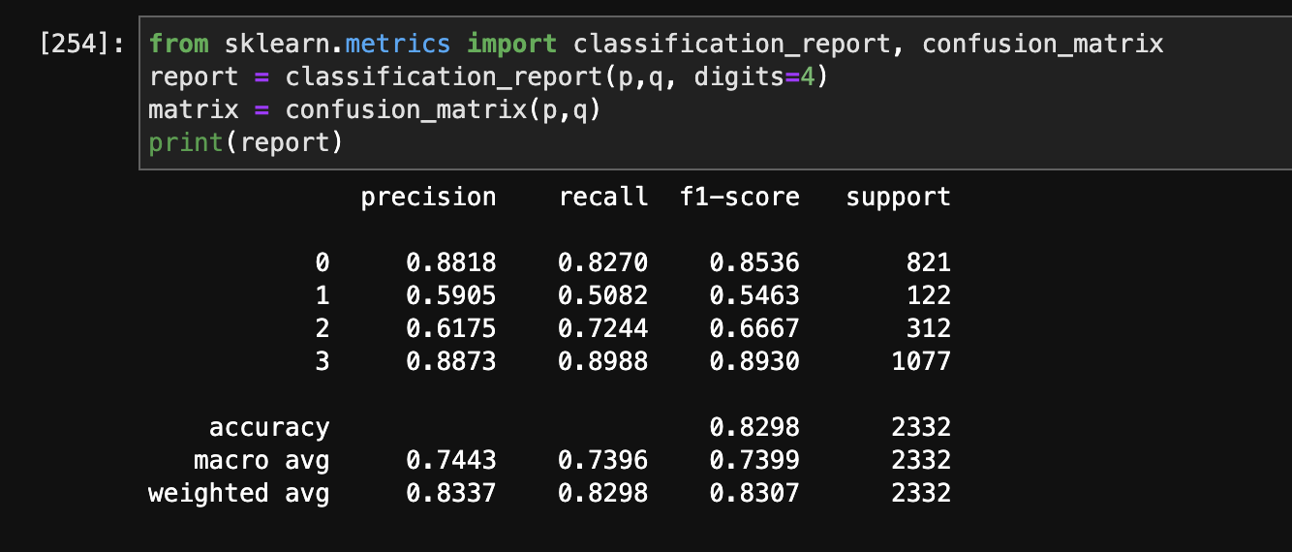
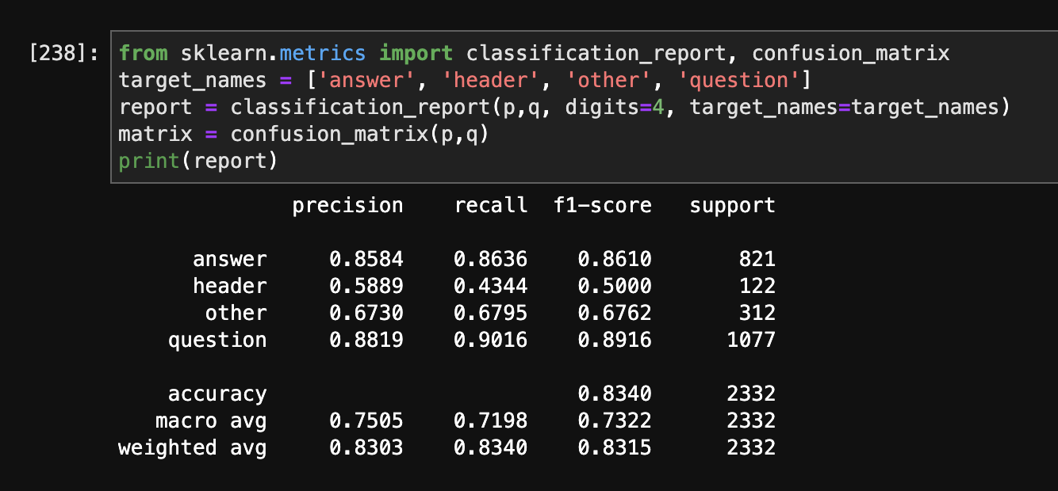
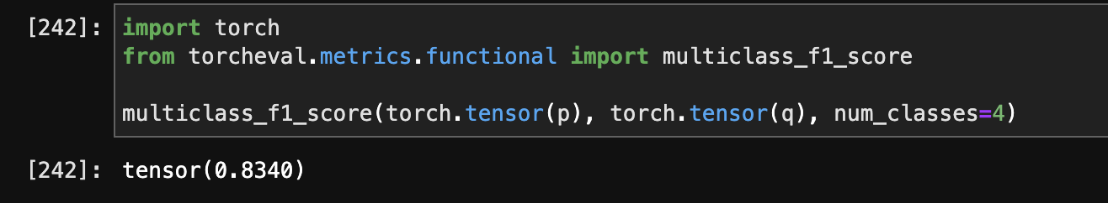
Classification Report
Class Label Legends
0 – Answer ; 1 – Header ; 2 – Other ; 3 - Question

Slide 10
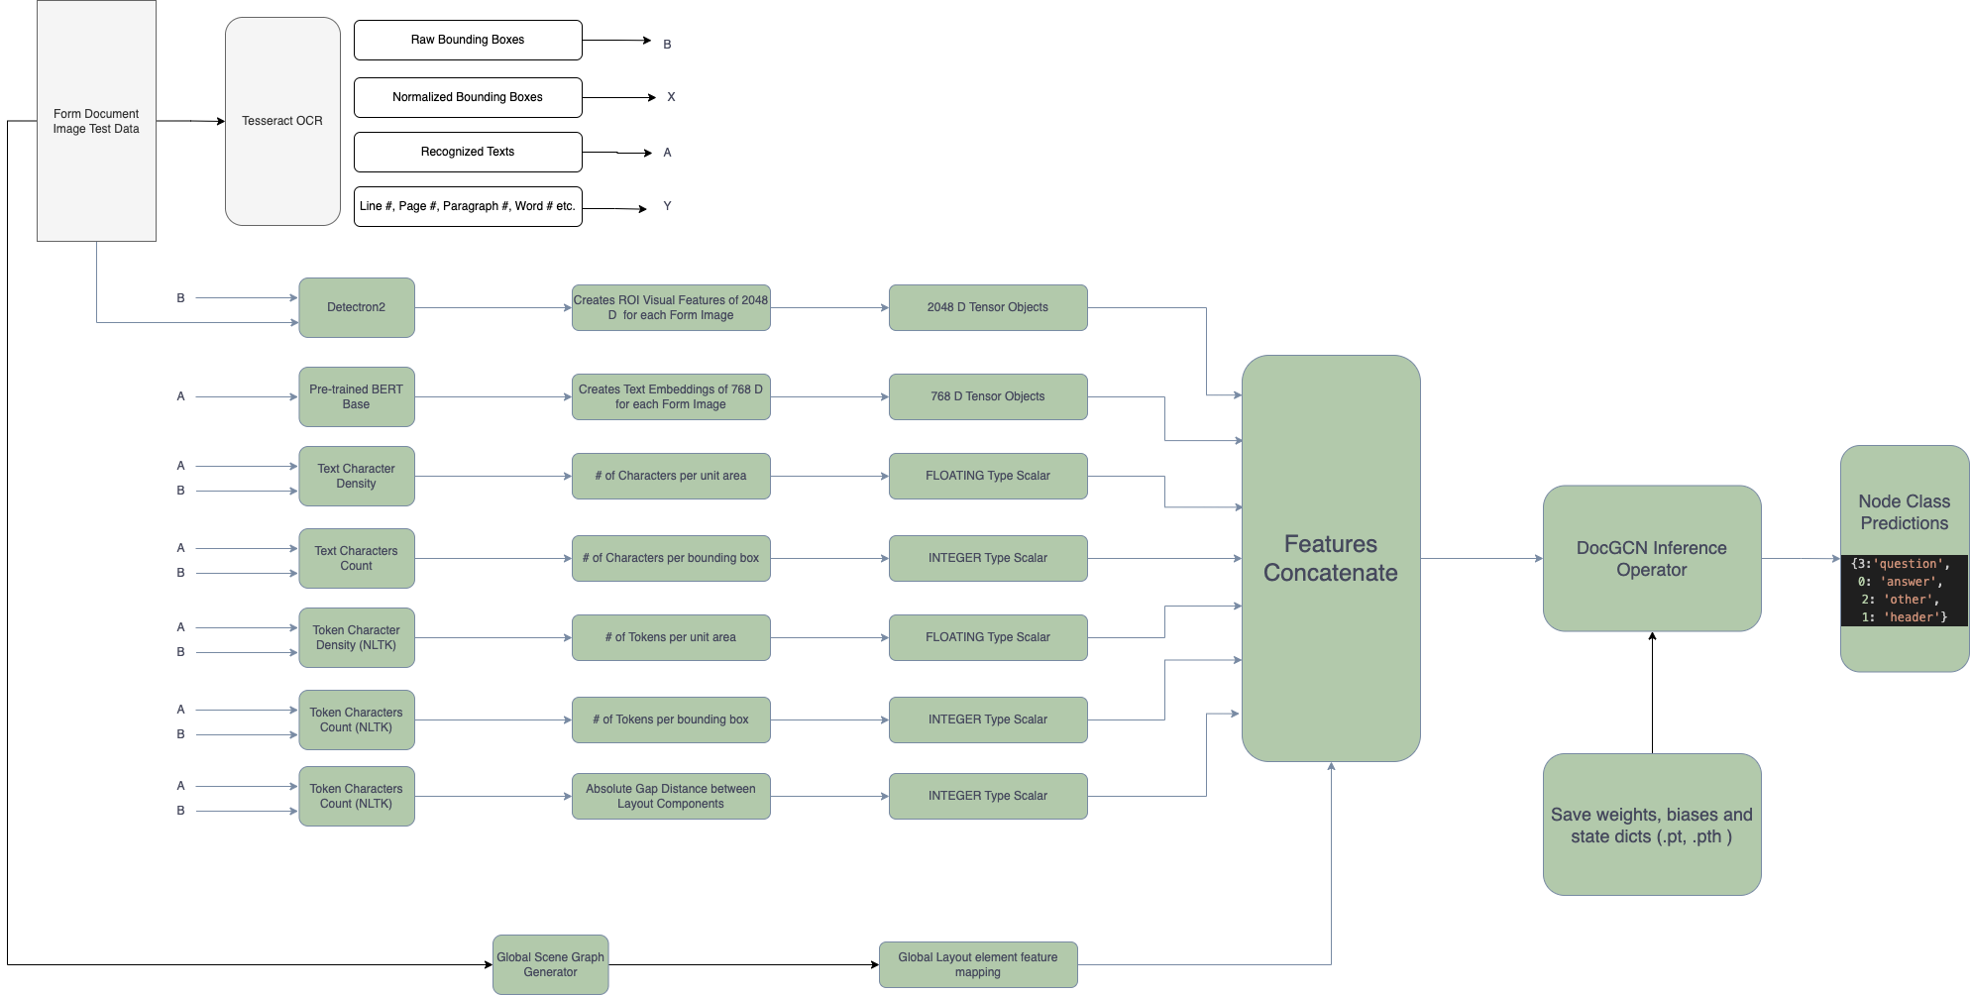
Inference Architecture

Slide 11
Inference Time
Iterations | CPU Inference Time | Single Node GPU Inference Time | Document Sample
1 | 48.58 sec |  | 83443897.png
2 | 92.101 sec |  | Test_form1.png
3 | 74.53 sec |  | Test_form2.png
4 | 55.71 sec |  | Test_form3.png
5 | 54.30 sec |  | Test_form4.png
6 | 142.67 sec |  | Test_form5.png
7 | 28 sec |  | Test_form6.png

Slide 12
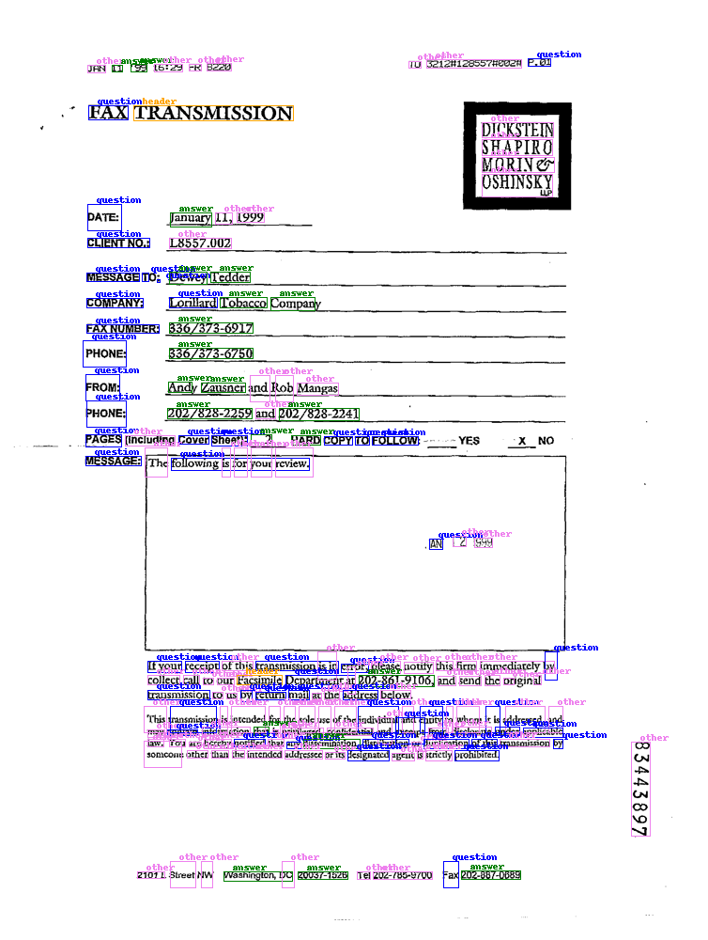
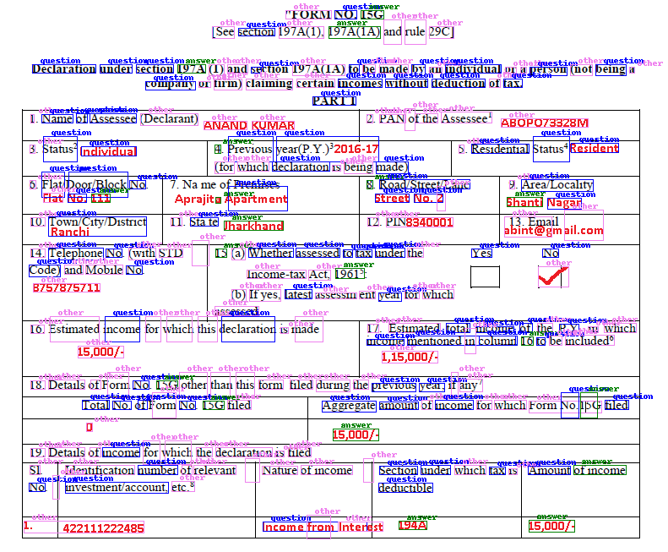
Sample Results

Slide 13
<TBD>
 | Built-in | Custom | External

Slide 14
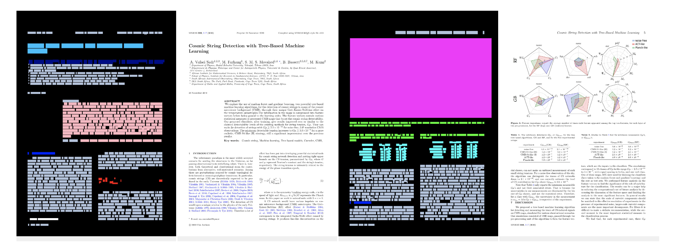
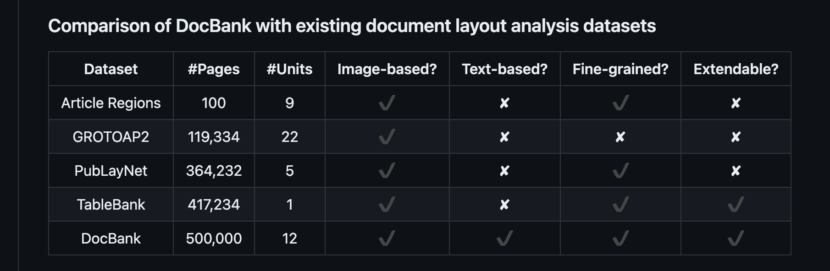
DocBank Dataset
DocBank is a new large-scale dataset that is constructed using a weak supervision approach.
It enables models to integrate both the textual and layout information for downstream tasks.
The current DocBank dataset totally includes 500K document pages, where 400K for training,
50K for validation and 50K for testing.
Each line contains a token and the following information of it:
bounding box ((x0, y0), (x1, y1)) - > (x0, y0, x1, y1)
color (R, G, B)
font
label

Slide 15
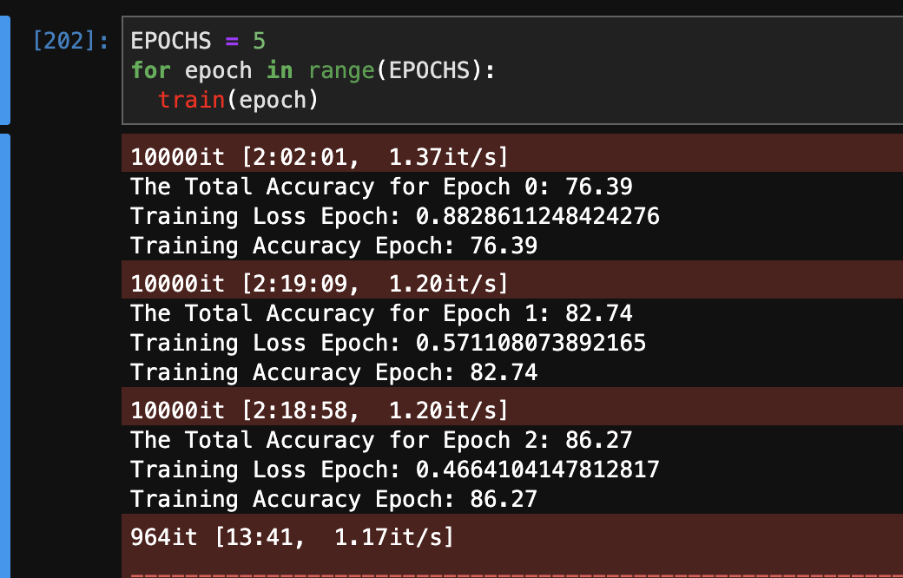
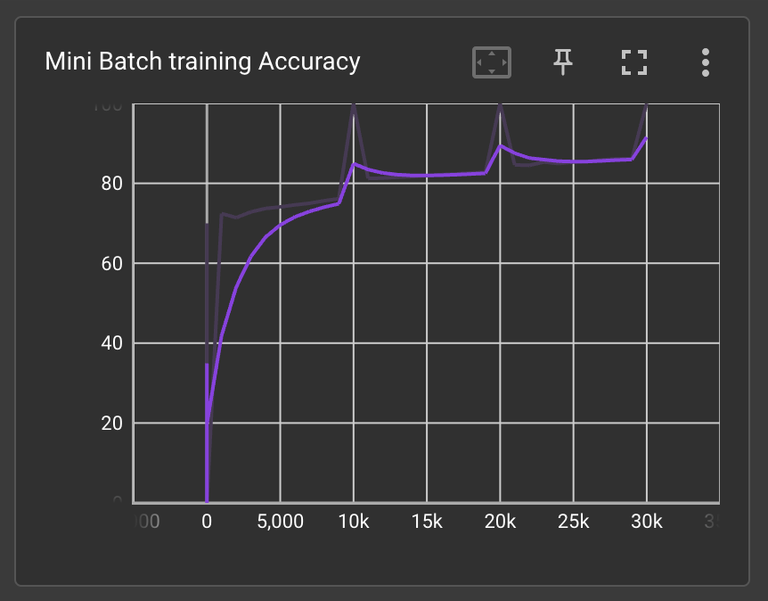
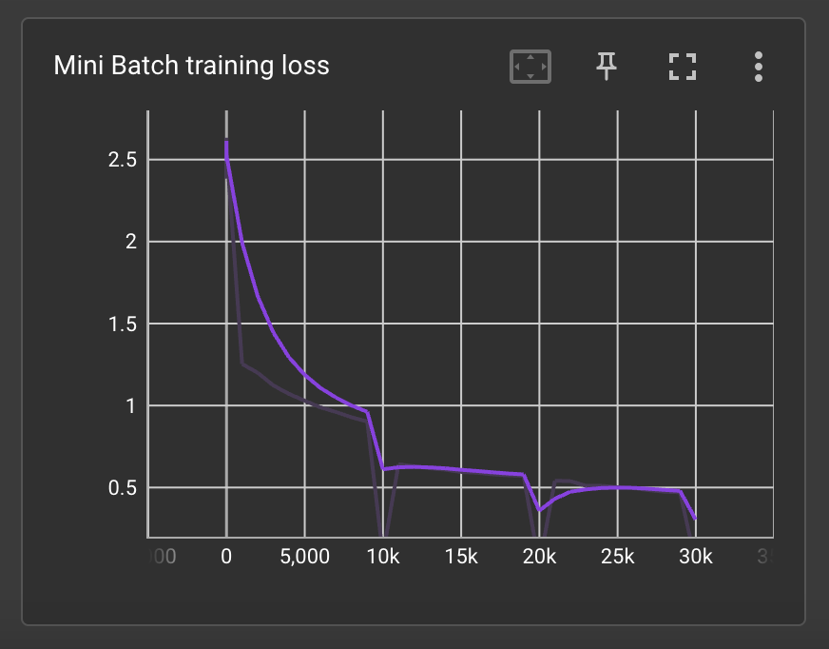
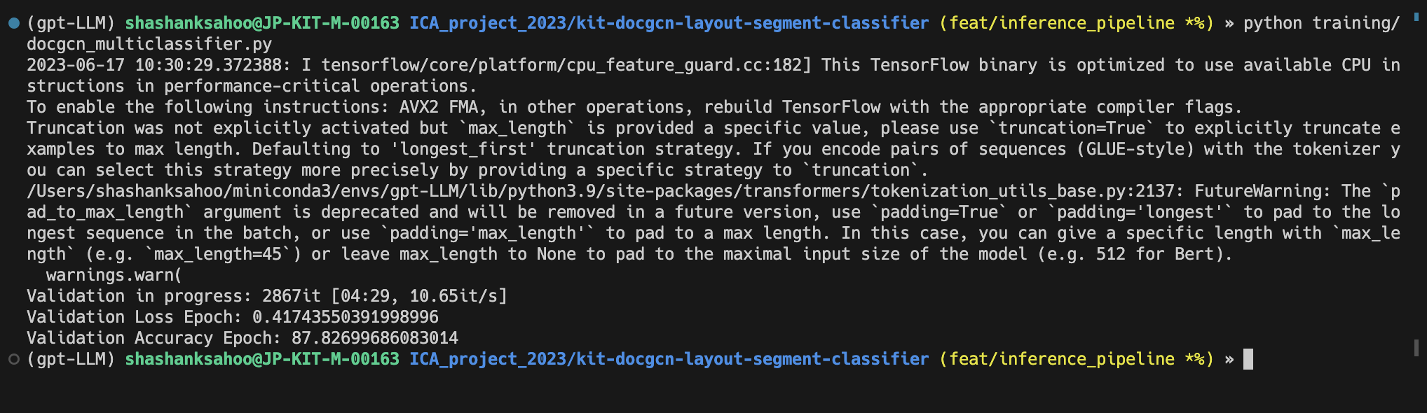
DocBank Metrics

Slide 16
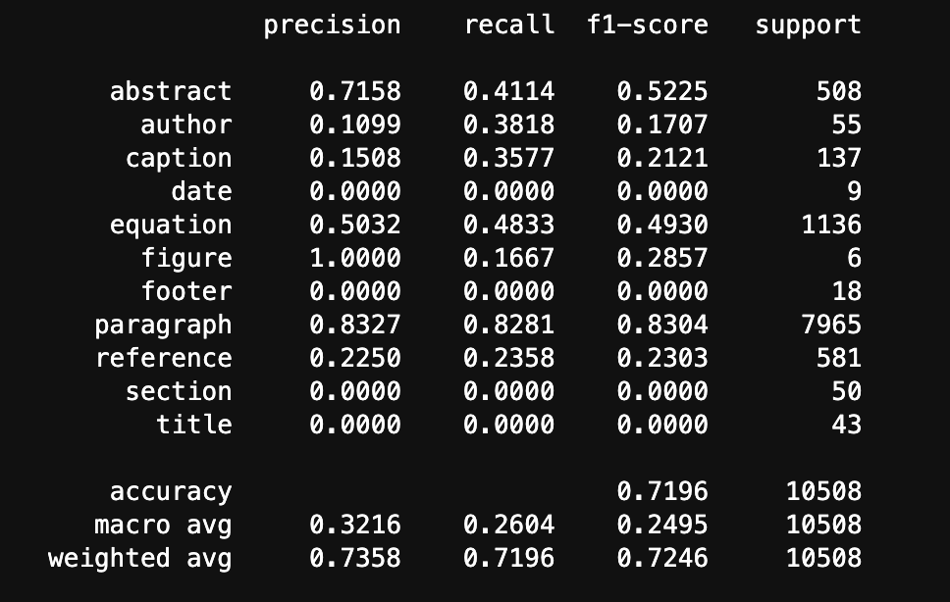
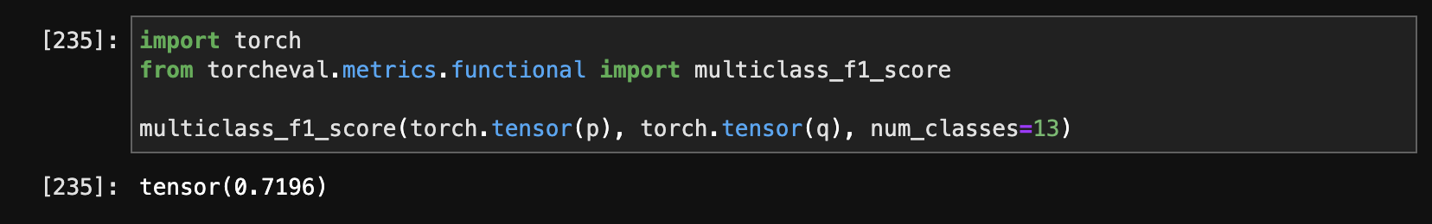
DocBank Metrics

Slide 17
DocGCN Training Pipeline
Raw Image + Annotations
Image Pre-processing and visual features
Text Pre-processing and textual features
Relational Scene Graph generation (Global)
Step 1
Step 2
Step 3
DocGCN Layout Multi-class classifier model
Parent Child relation hierarchy based GCN
Layout Gap Distance based weighted GCN
Step 6
Step 5
Step 4

Slide 18
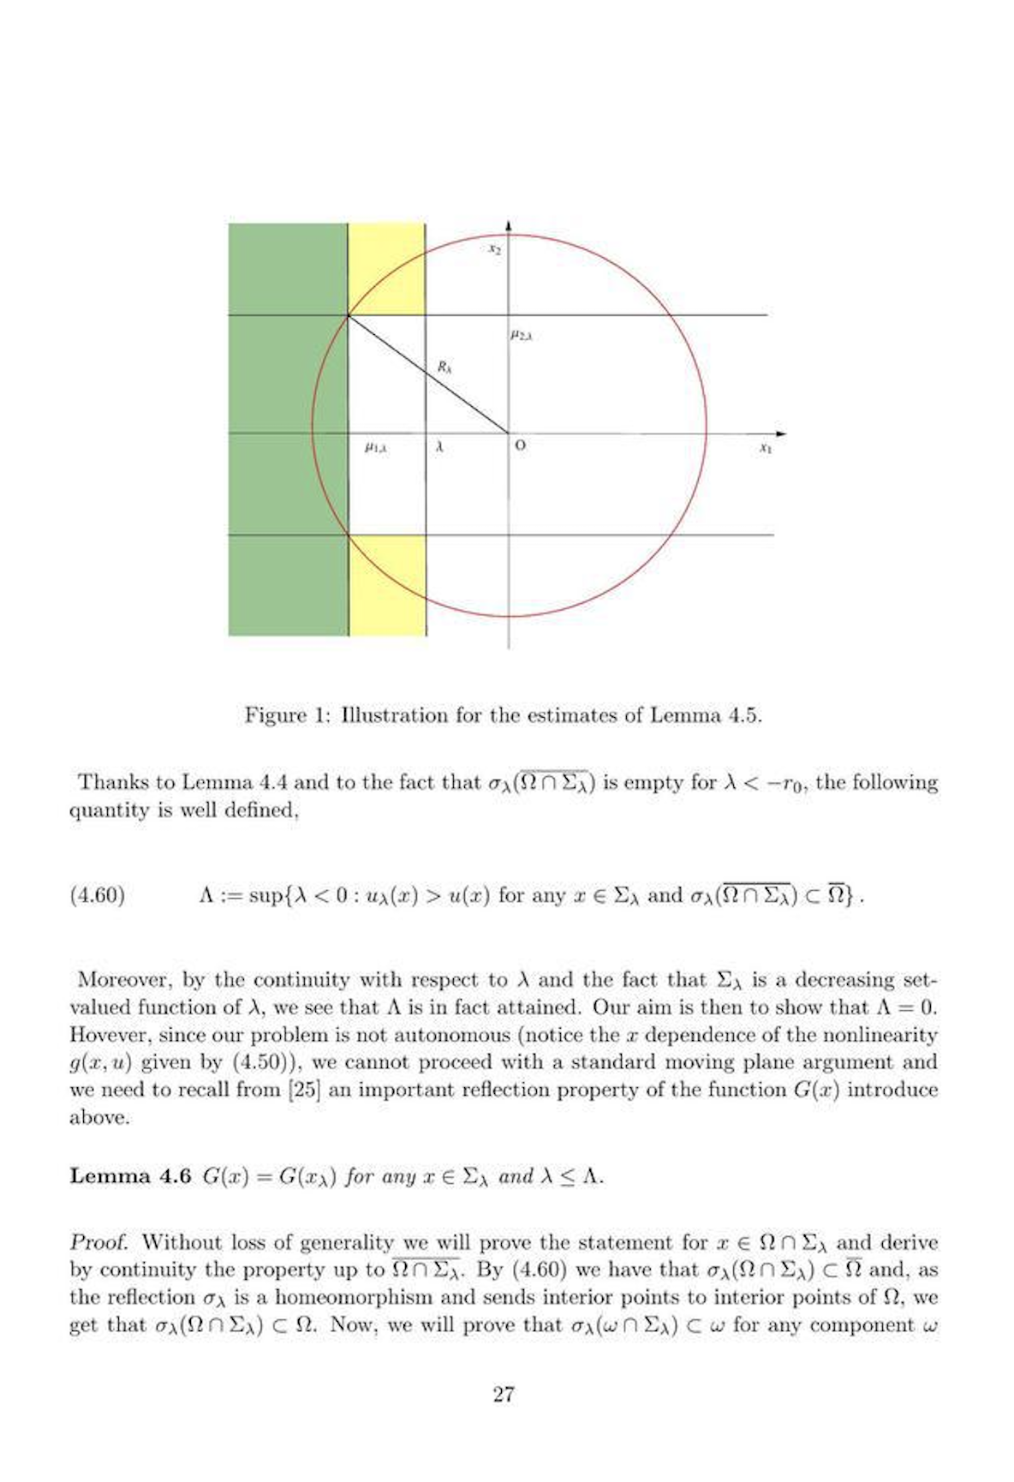
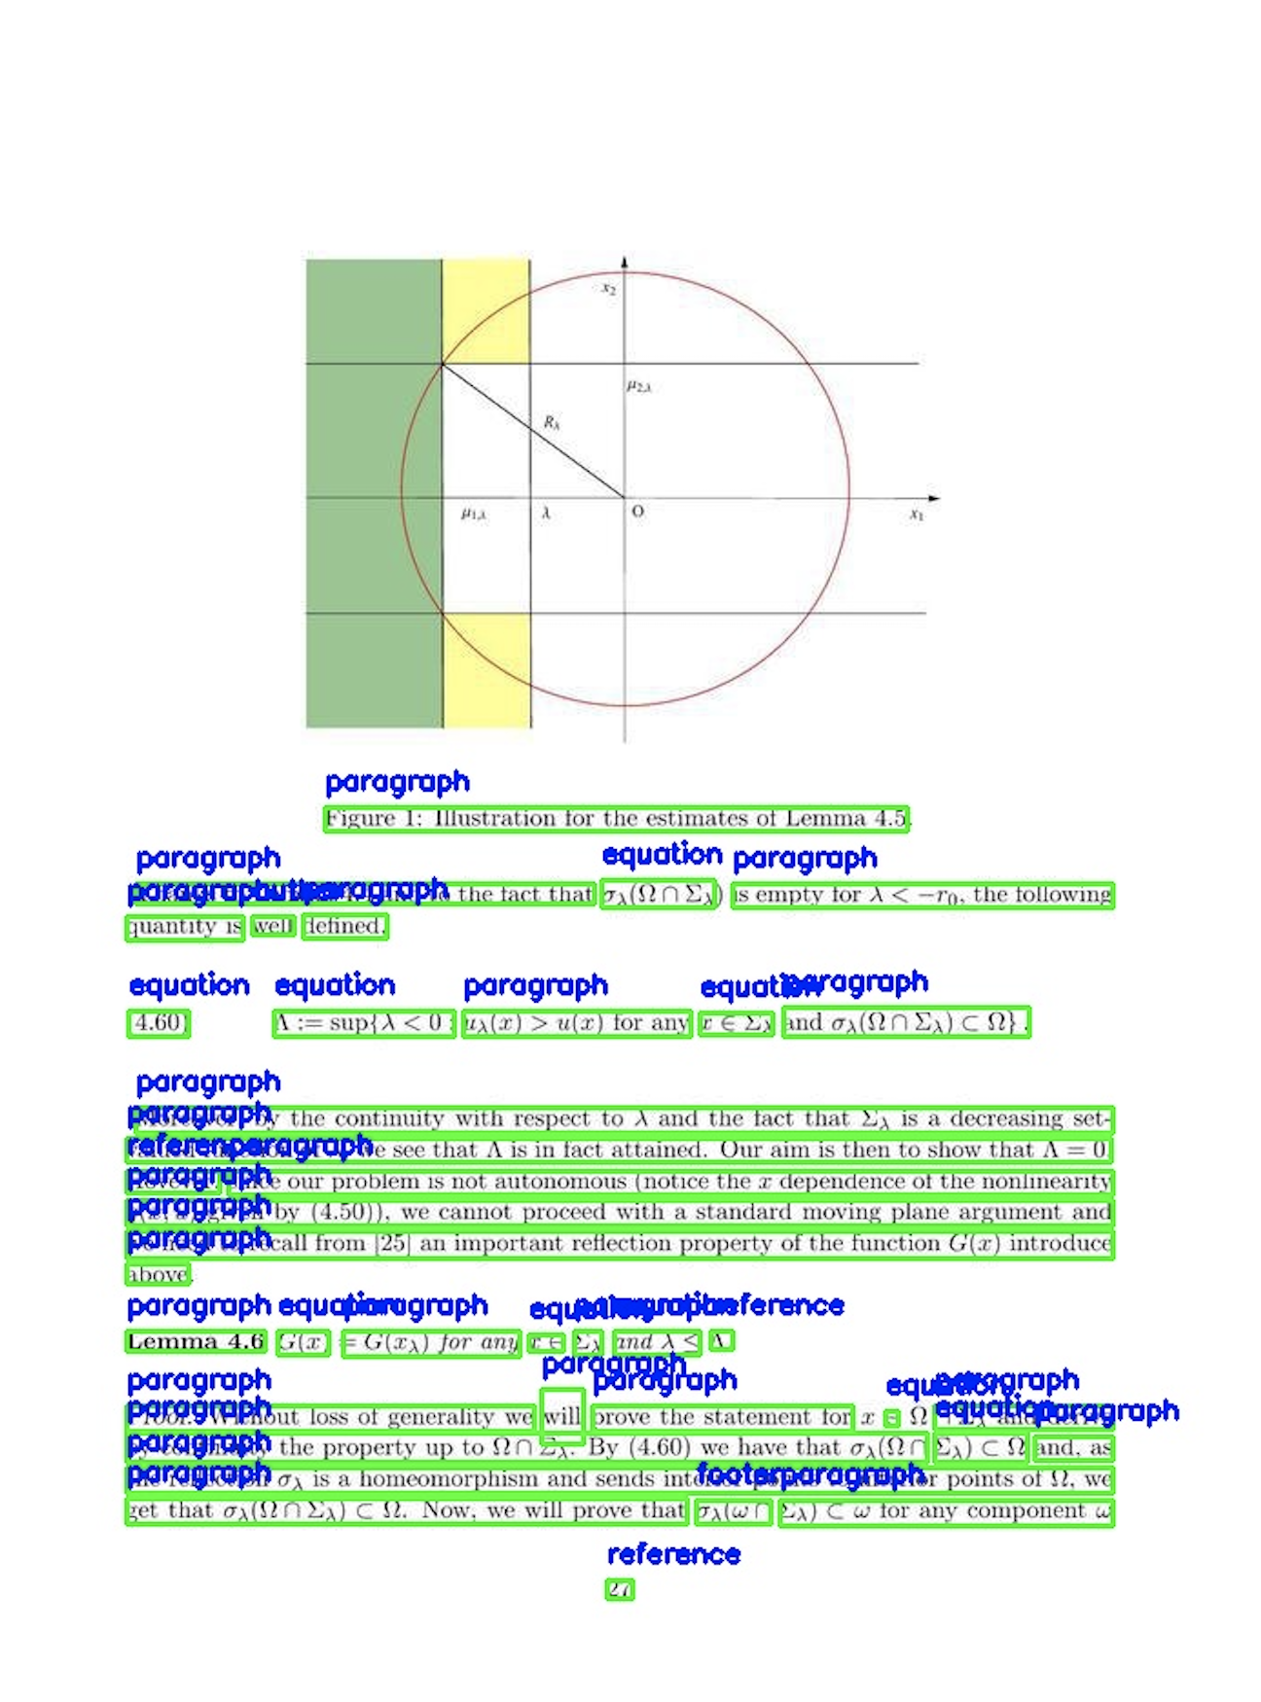
DocGCN Inferencing Pipeline
Raw Test Image
PyTesseract OCR to get Text and Bboxes
Image features extraction
Text features extraction
Step 1
Step 2
Step 3
DocGCN Layout Multi-class classifier model
Feature concatenation for Dense layer
Node embeddings from GCNs
Step 6
Step 5
Step 4
Bboxes + Prediction Labels
OCR Overlay with Bbox merging
Step 7

Slide 19
DocGCN Classes
Docgcn_mapped_labels = {
0: "abstract",
1: "author",
2: "caption",
3: "date",
4: "equation",
5: "figure",
6: "footer",
7: "paragraph",
8: "reference",
9: "section",
10: "title",
}
unmapped_labels = {
0: ”list",
1: ”table"
}

Slide 20
DocGCN Next Steps
Points to wrap up:
To wrap up in SP 115
Evaluate in July 2023

